Slide 1
Working on NetCDF files

Slide 2
We will work on the ubuntu via the MobaXterm terminal
We first converted the NetCDF which is on projected grids to CF-compliant NetCDF.
For example:
$ ./convert_CF.sh -i 2015112900WRF2HBV.nc -o 2015112900WRF2HBV.CF.nc
We can verify the created NetCDF
$ ncdump – h 2015112900WRF2HBV.CF.nc

Slide 3
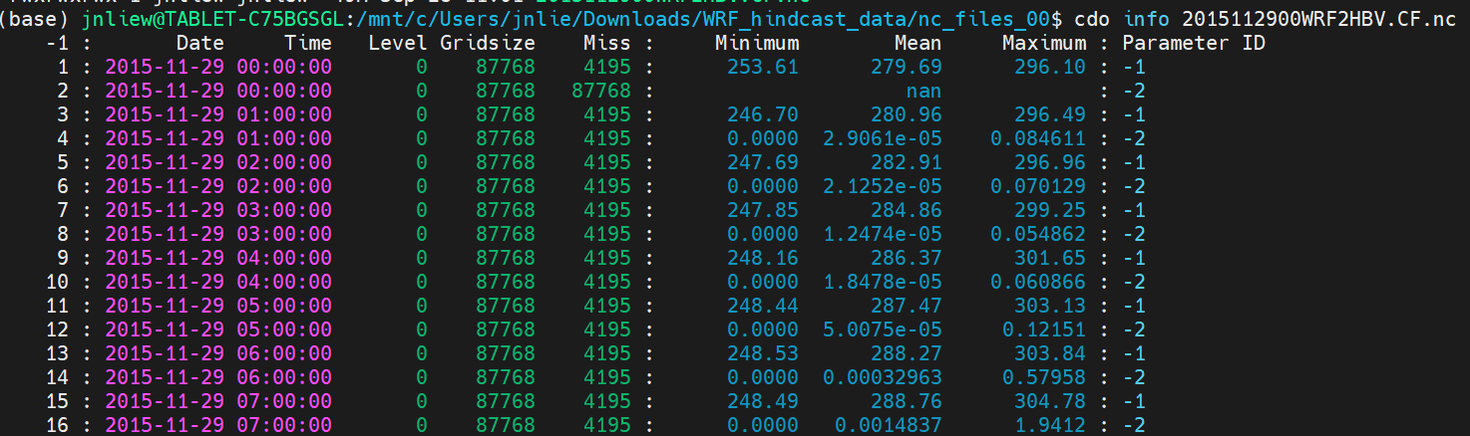
Note that each file contents 73 time-steps (3 days forecast).
Note that the first time-step (t=0) is the initialization and the precipitation is N/A and the temperature is interpolated from the coarse domain.
We can check this with a simple tool ncview. Or use the climate data operator:
$ cdo info 2015112900WRF2HBV.CF.nc

Slide 4
We can remove the first time-step with:
$ cdo delete,timestep=1 2015112900WRF2HBV.CF.nc 2015112900WRF2HBV.CF.cut.nc
And then check again with ncdump –h.
Computing daily statistics can be done easily with CDO.
Example:
$cdo daysum -selvar,precipitation 2015112900WRF2HBV.CF.cut.nc PRCP_2015112900WRF2HBV.CF.daysum.nc
$cdo daysum -selvar, TMP_2maboveground 2015112900WRF2HBV.CF.cut.nc TMP2_2015112900WRF2HBV.CF.daymean.nc
The daily statistics are computed based on the date/time stamp.

Slide 5
If we want to compute the statistics based on time-steps instead of dates:
$cdo timsum -seltimestep,1/24 -selvar,precipitation 2015112900WRF2HBV.CF.cut.nc PRCP_2015112900WRF2HBV.CF.01_24.nc
$cdo timsum -seltimestep,25/48 -selvar,precipitation 2015112900WRF2HBV.CF.cut.nc PRCP_2015112900WRF2HBV.CF.25_48.nc

Slide 6
Cropping into region
We can select the data only over a specific box given the bounds of longitude and latitude.
e.g
$ cdo sellonlatbox,89.1,89.9,26.6,27.9 2015112900WRF2HBV.CF.cut.nc 2015112900WRF2HBV.CF.cropped.nc
This will crop the region into the specified lon/lat box.

Slide 7
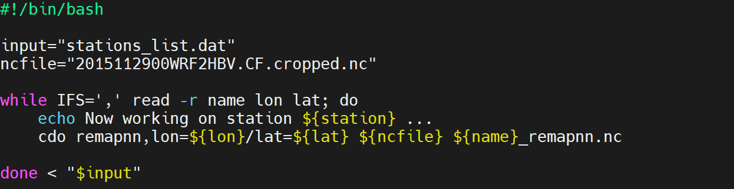
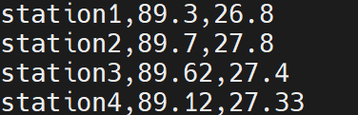
Select single points
Use the following command to select specific point:
cdo remapnn,lon=89.5/lat=27.3 2015112900WRF2HBV.CF.cropped.nc 2015112900WRF2HBV.CF.lon89.5_lat27.3.nc
If you have multiple points, we can put this points into a text file and write a simple shell script to loop through the lines. For instance we can use text editor to create a list of stations with longitude/latitude information.
Create the script and run it on the prompt.
Create a ASCII text file called “stations_list.dat”

Slide 8
Output the values to ASCII text
We can write out the values in ASCII, so that we can use them in other program. Let’s output the precipitation and TMP_2maboveground into ASCII text:
$ cdo outputtab,date,time,lon,lat,value -selvar,TMP_2maboveground 2015112900WRF2HBV.CF.lon89.5_lat27.3.nc >tm2_2015112900.dat
$ cdo outputtab,date,time,lon,lat,value -selvar,precipitation 2015112900WRF2HBV.CF.lon89.5_lat27.3.nc >pr_2015112900.dat
Then, check the two created files with your text editor.

Slide 9
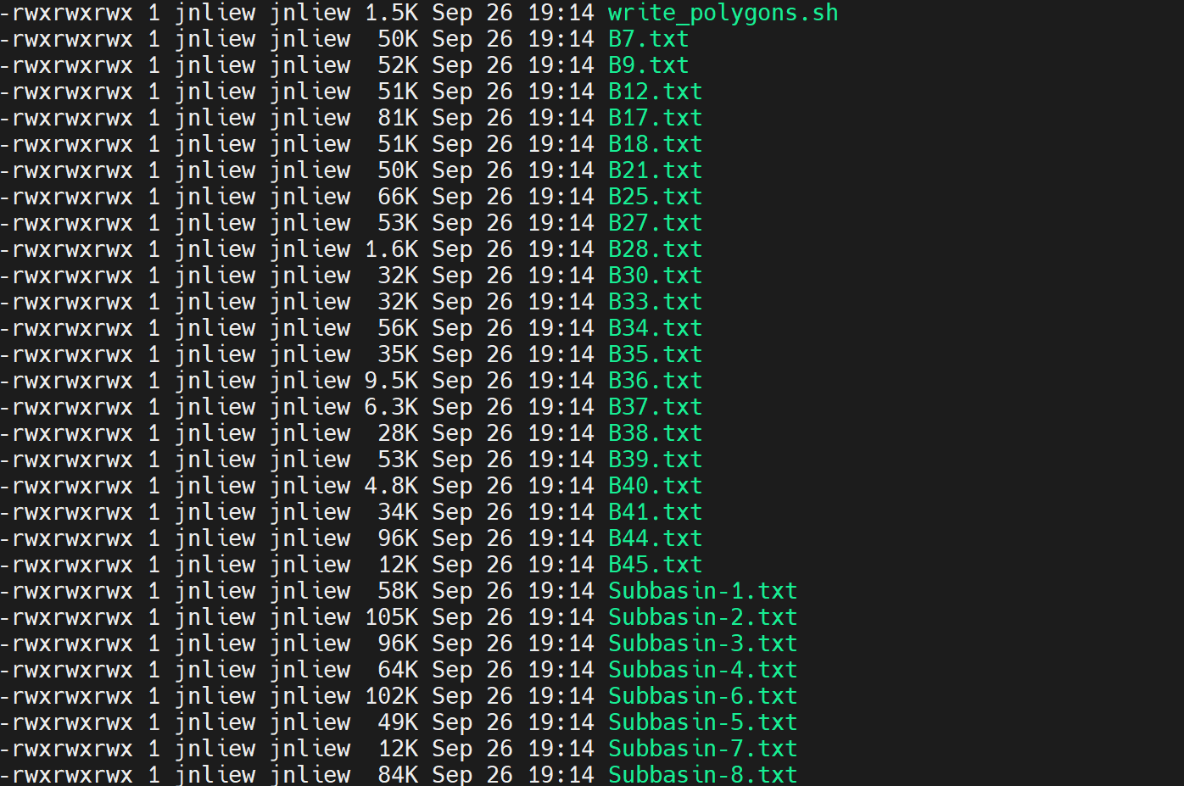
Mask a region and create a areal-averaged values.
First we need to create masking boundary for the region we want.
We can create this from the shapefile. These files were already created, and the files are named according to the attribute “name”:

Slide 10
Copy the subcatchment boundary file over to your working directory and run the following cdo command:
cdo fldmean -maskregion,Subbasin-1.txt 2015112900WRF2HBV.CF.cropped.nc Subbasin-1-2015112900WRF.nc
Copy the created file Subbasin-1-2015112900WRF.nc will contain the sub-catchment averaged rainfall, considering all the points following under this polygon.

Slide 11
Selecting and merging time-steps.
Compute long-term statistics.

